Slide 1
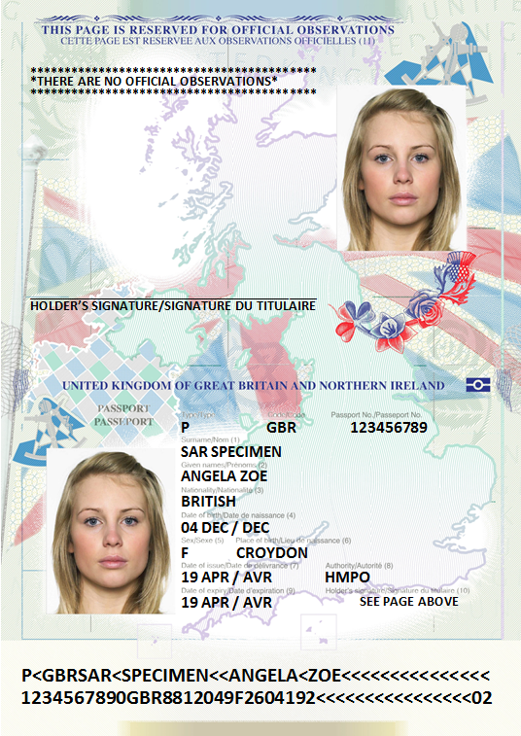
Check that your passport is signed
Your passport is not valid without a signature – ensure that yours is signed today.
If your UK passport shows ‘SEE PAGE ABOVE’ on the page containing your name and date of birth, please sign using black biro on the line provided.
If your passport contains a digital copy of your signature, or states ‘THE HOLDER IS NOT REQUIRED TO SIGN’, no further action should be taken.
It is your responsibility to ensure that the passport is correctly signed before use. If you make a mistake you could face delays, or be denied entry at border crossings, or onto flights.
Please be aware that you will be charged the full fee if you need to replace your passport.
For any queries about the signature in your passport, please call the Passport Adviceline - 0300 222 0000

Slide 2
Handwritten signatures in passports
From October 2016 UK passports may contain either a digital or handwritten signature
If ‘SEE PAGE ABOVE’, is shown on the page containing the passport holder’s name and date of birth, they must sign the book on the on the line provided.
If the passport contains a digital copy of the signature, or states ‘THE HOLDER IS NOT REQUIRED TO SIGN’, the passport should not contain a handwritten signature.
In the event that a customer may have forgotten to sign their passport, please conduct your usual checks to be satisfied that the passport is genuine.

